Slide 1
SIMS – HR Assistant Concepts
Andy McGowan
Updated 27 Sept 23

Slide 2
Using an external HR system
HR Assistant enabling an external HR system
SIMS has been the source of HR data for many years, however there is an increasing need for MATs and School Groups to manage Staff centrally because they are employed from centre rather than by the school themselves.
HR Assistant in various guises enables SIMS to maintain a basic staff list to enable academic management and to keep the data in SIMS up to date.

Slide 3
Source of truth
Changing perceptions
HR Assistant can create new staff and maintain existing staff, however it maintains a small subset of staff data and maintains a current employment record rather than a history or detailed contract data.
Users will need to change their perception of where data is held and how to obtain staff data which often means a change of mindset for customers. Staff next of kin contact details for example will correctly be in the HR system (which is no longer SIMS) and access is typically limited to the personnel team in the MAT/School quite correctly under GDPR.
On transition from SIMS to the HR system, the data in SIMS will be accurate and up to date. As time progresses, the accuracy of the non maintained data will diminish and schools will need to decide how to manage this data

Slide 4
Aged data in SIMS
Changing perceptions
Moving forward with an HR system, the data about pay, contracts, checks, … will be held in the HR system – so what are the options for data in SIMS?
Option #1
Post transition, schools could simply delete all of the old data which would mean going through each of the current staff records and deleting contacts, checks, … However, schools may want to retain historical data – The HR system for example would likely hold checks from the migration date forward. Former staff records for staff who were not migrated to the HR system may need to be kept for a period for the purposes of references.

Slide 5
Aged data in SIMS
Changing perceptions
Option #2
Schools could choose to terminate contracts, checks, … as of the date of HR migration.
In some sense this makes the data incorrect because Fred’s contract was not actually terminated on that date but at least when asked, SIMS would not return incorrect data. For example most teachers are considered for pay review in September and hence pay range / scales would change. If open ended contract / pay range / scale records are left and say used to populate the budget planning tool then numbers may be subtly wrong whereas if all contracts were ended on transition then a zero pay bill would clearly highlight the need to obtain data from the source of truth.

Slide 6
Aged data in SIMS
Changing perceptions
Why has ESS not provided tools to assist?
There is no right answer. Deleting non-maintained staff data or terminating records on the date of transition are valid options but might need to be applied selectively based on the needs of the school. Both processes are not easily reversible and thus need user input.
It is not a good choice for the school for imply ignore the problem. In the case of a GDPR challenge, it is usually best to have considered the problem, decided on a course of action even if that is to ‘do nothing’ and this was in hindsight the wrong answer.

Slide 7
Keep it Simple
SAM – SIMS Integration
The key loser in this is reporting because data in different systems is difficult to join together.
Initially the plan is to provide the curriculum data for SWC/SWAC returns from SIMS to SAM to facilitate the returns to be made from SAM on behalf of the MAT.
In the medium term, the plan will be to extract data from SAM and make it available via SIMS and new Reporting/BI facilities.
Other SIMS Technical Integrator Products may need to either obtain their HR specific data from SIMS or directly from SAMpeople.

Slide 8
Getting Started

Slide 9
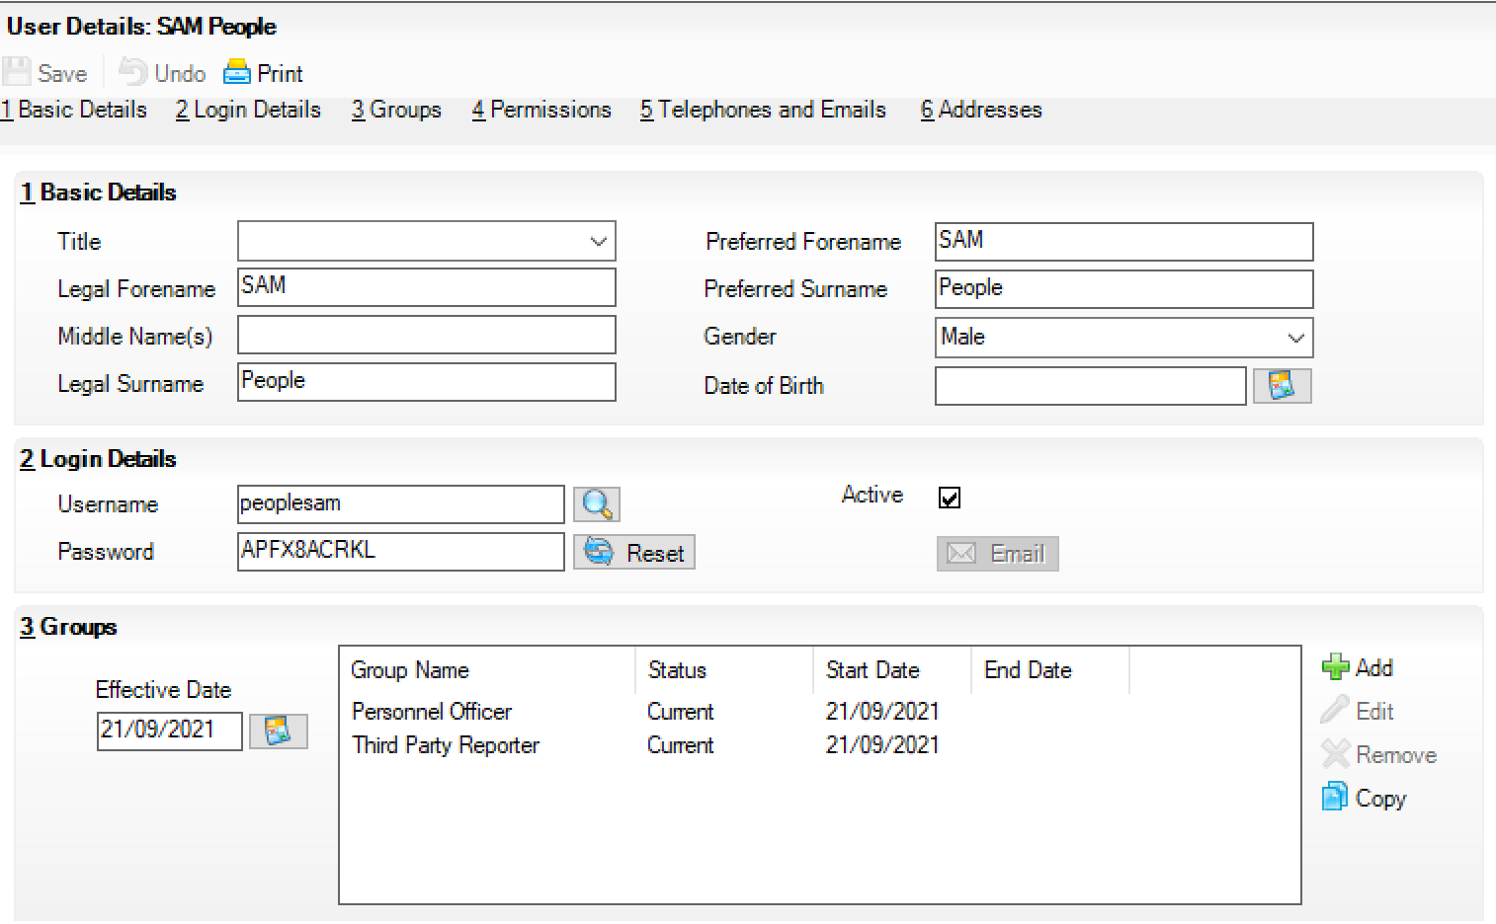
Setup SIMS
Add a User for SAMpeople
Give it a name
Add Groups:
Personnel Officer
Third Party Reporting
Harvest the temporary password
Use these credentials to log in to SIMS
Set the password to something obscure.

Slide 10
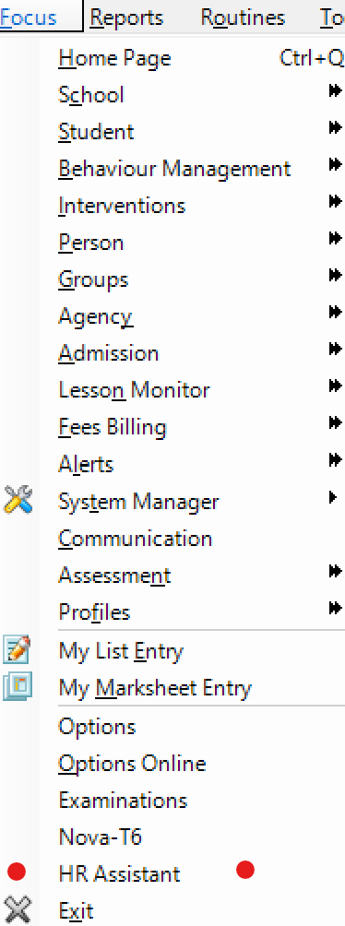
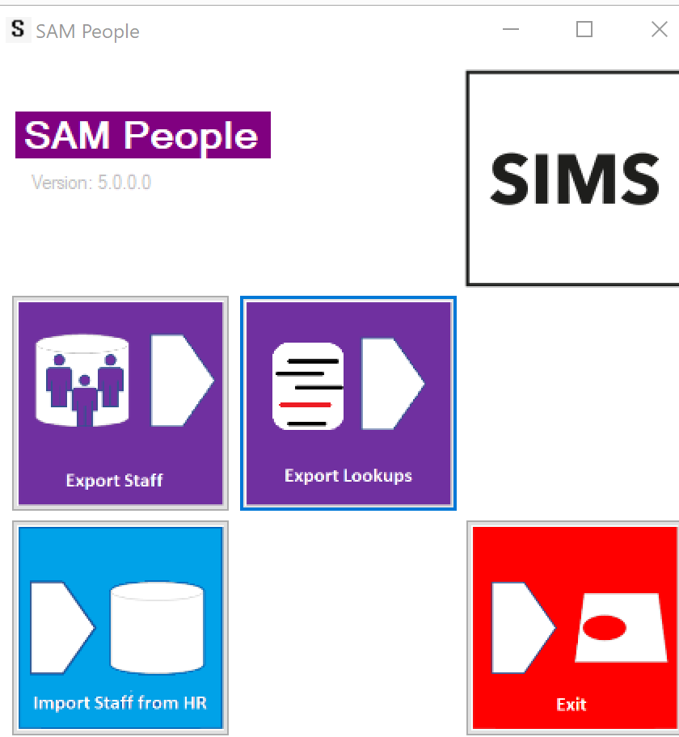
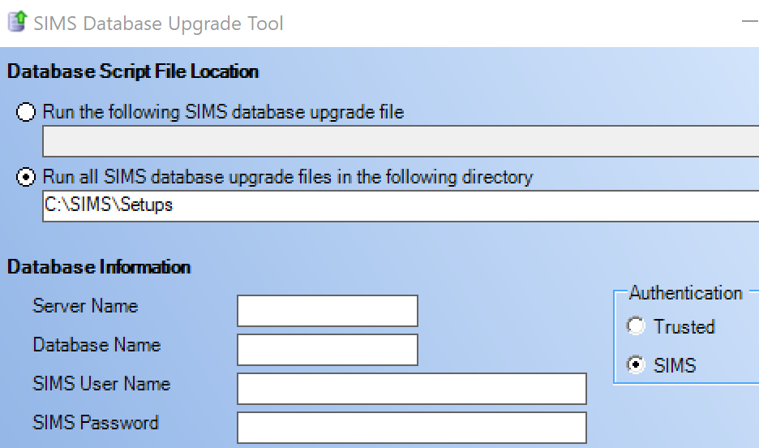
Apply the SIMS Licence
Either via SOLUS or dBUpgrade
Solus
The patch is assigned to the school and will either trigger automatically if set for auto-update or need to be triggered by the network manager.
dBUpgrade
Download the HR Assistant Licence Patch.
Use dbUpgrade to apply it.
NB: Whilst the UI version will be enabled. It is unlikely that it will be needed except for disaster recovery.
SAM People HR Assist Licence | ESS Portal (sims-partners.com)

Slide 11

Set Up SAMpeople
Advice to follow
You will need the SIMS User from earlier.
Harvest your SAM Credentials
User Name
Password
Server
Database

Slide 12
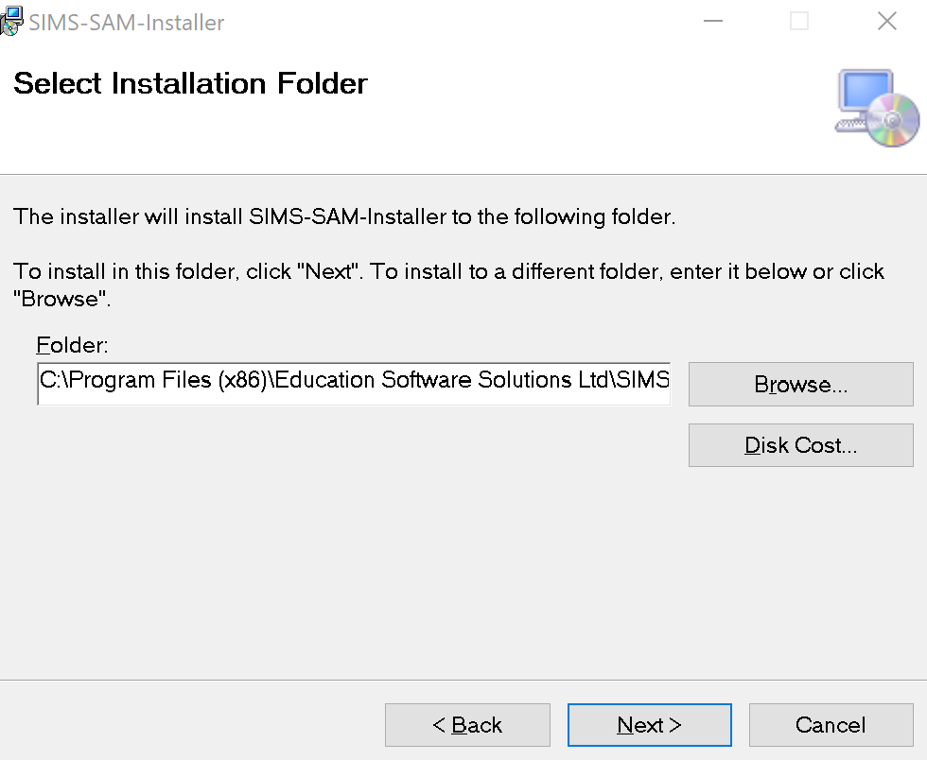
Install HR Assist Command Line
Network Manager
Click on a link
SIMS-SAM-Installer | ESS Portal (sims-partners.com)
Press Next…[4 times]

Slide 13
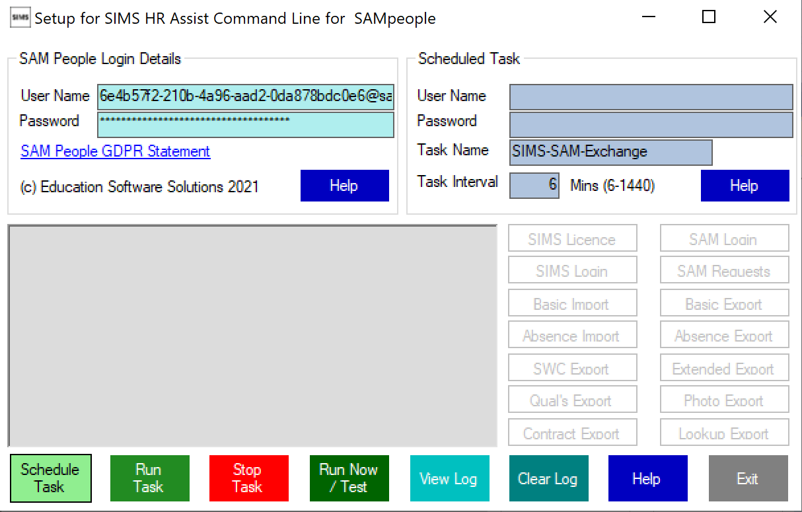
Configure the data exchange
Our configuration application is launched by the installer.
Check out the GDPR statement
Enter your SAM Credentials
SAM will be automatically configured in an onboarding mode which on early use will largely pull data from SIMS. This will make the onboarding journey as simple and pain free as possible.

Slide 14
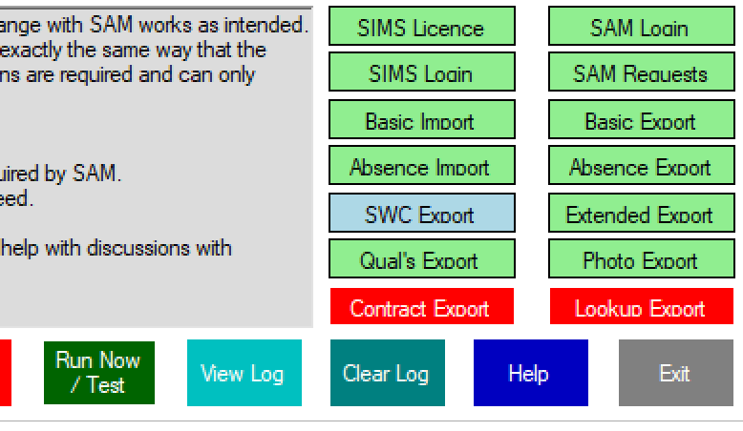
First exchange
Click the run now button. The ideal solution would be for none of the buttons to turn red, blue buttons are fine because there won’t be data to push back to SIMS initially and SWC won’t be ready. SAM however will control the flow of data that it needs to optimise loads on both systems. For example photos may be updated monthly. You will get help and assistance to resolve any red boxes from the onboarding support team.

Slide 15
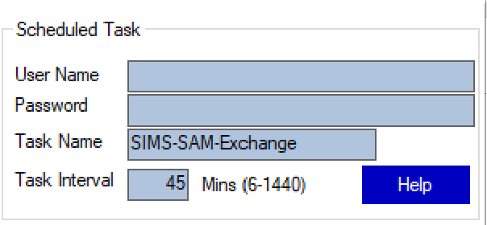
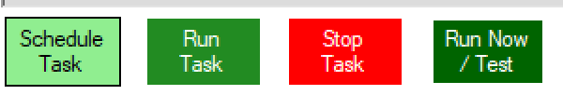
Setting up the task
Automating data exchange
These sections allow a scheduled task to be set up for hands free operation. You will likely need to create a windows user with rights to run SIMS and scheduled tasks and enter the credentials. Decide on the frequency of update – NB: These are normally lightweight calls that do nothing unless needed. Press Schedule Task. Note that the task name identifies this task which means that more than one SIMS system can be synchronised from one machine.
You can also stop and test the scheduled task.

